Slide 1
Information Retrieval System
Alexandria Persing

Slide 2
What is an Information Retrieval System?
How does mine work?
Content Tree
Building a Document Profile
Comparing Documents
Recall and Precision

Slide 3
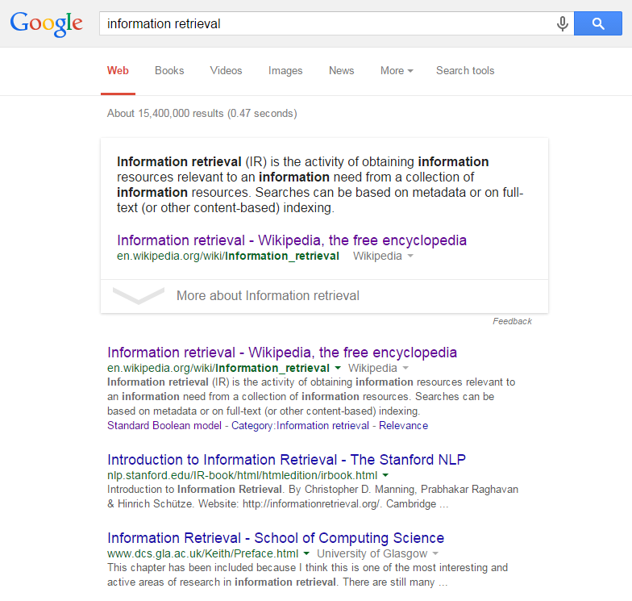
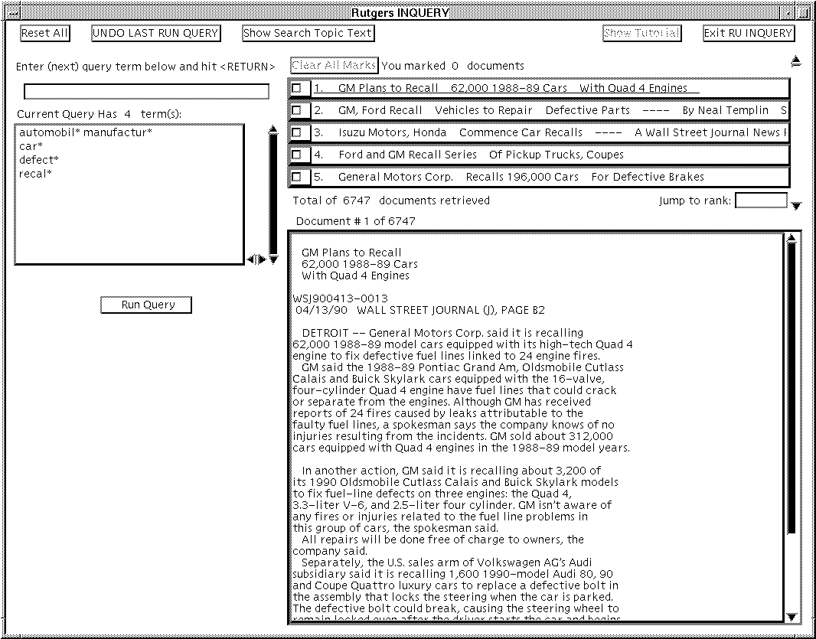
What is an Information Retrieval System?

Slide 4
How does mine work?
Based on the idea of there being “Content Trees” from which document profiles are built
You then compare the document profiles to determine similarity

Slide 5
Content Tree Example
All
Animals
Government
Food
Laws
Pets
Zoo
Elections
Cat
Dog
Giraffe
Voting
Cookie
Farm
Cow
Chicken
Beef
Hamburger
Steak
Cooking
Baking

Slide 6
Building a Document Profile
I like lots of food, but I like cows because they turn into steak.
All
Animals
Food
Farm
Cow
Beef
Steak
1
2
1
1
1
1
1

Slide 7
Comparing Profiles
All
Animals
Food
Farm
Cow
Beef
Steak
All
Animals
Food
Farm
Cow
Cooking
Beef
Hamburger
All
Animals
Government
Pets
Dog
Laws
2
1
2
1
1
3
1
1
1
1
1
1
2
1
1
1
1
2

Slide 8
Recall and Precision
Measurements for determining how well the system works
Recall:
Number of relevant documents retrieved / Total number of relevant documents
Precision:
Number of relevant documents retrieved / Total number of retrieved documents

Slide 9
My Current Recall and Precision
Average Matching Queries to Documents:
Recall: 26.5%
Precision: 4.3%
Average Matching Documents to Documents (based on expected query results):
Recall: 19.4%
Precision: 27.4%

